Slide 1

Incorporating AI
into Teaching
Kerry Back
Rice University
FMA 2025

Slide 2

JPMorgan: Chatbots to Agents
CNBC, September 30, 2025: In 2023, JPMorgan gave employees access to OpenAI's models through LLM Suite.
It was essentially a corporate ChatGPT tool used to draft emails and summarize documents.
About 250,000 JPMorgan employees have access to the platform today ... Half of them use it roughly every day.
JPMorgan is now early in the next phase of its AI blueprint: It has begun deploying agentic AI to handle complex multistep tasks for employees, according to an internal road map provided by the bank.

Slide 3
From Makers to Checkers
Derek Waldron, JP Morgan Chief Analytics Officer:
What we're working towards is that every employee will have their own personalized AI assistant; every process is powered by AI agents, and every client experience has an AI concierge.
You'll still have people at the top who are managing and have relationships with clients, but many, many of the processes underneath are now being done by AI systems.
Workers would shift from being creators of reports or software updates, or 'makers' ... to 'checkers' or managers of AI agents doing that work.

Slide 4
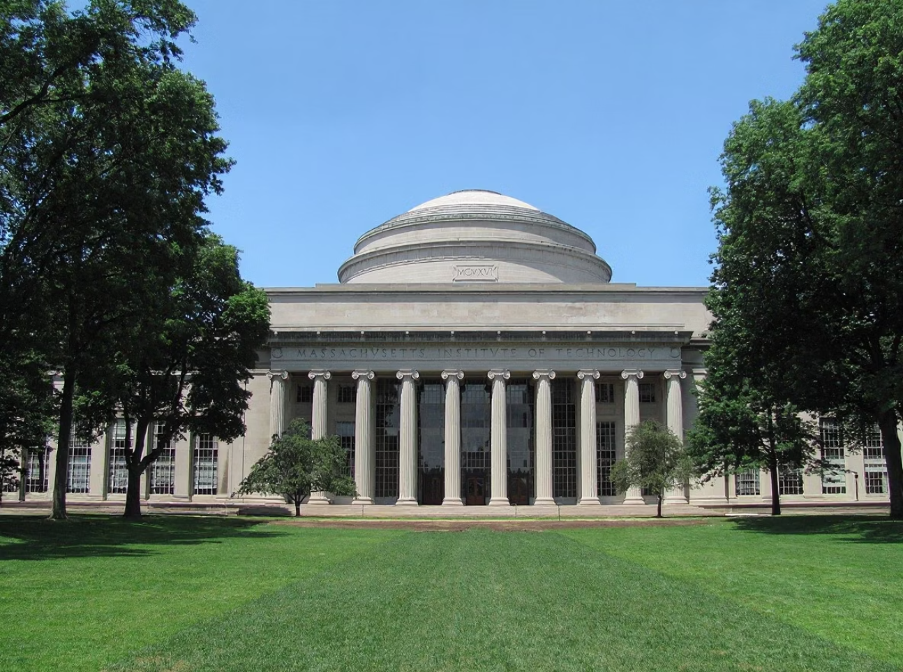
MIT/Media Labs Report
Pilots to Production
Only 5% of AI pilots reach production.
Used by Everyone
Workers from over 90% of companies surveyed reported regular use of personal AI tools for work tasks.
Almost every single person used an LLM in some form for their work.

Slide 5
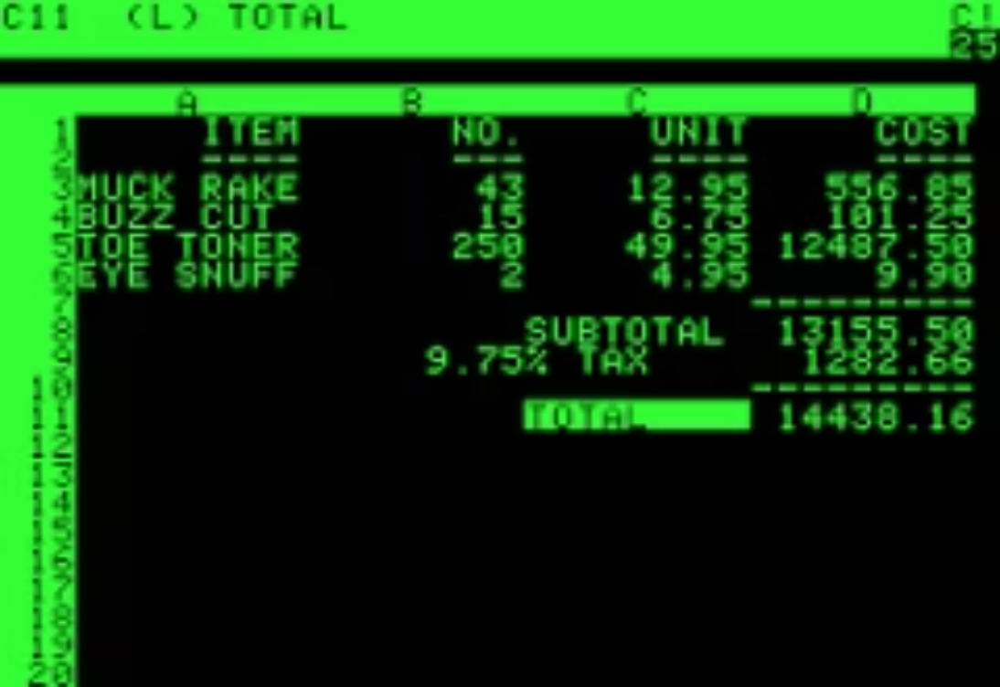
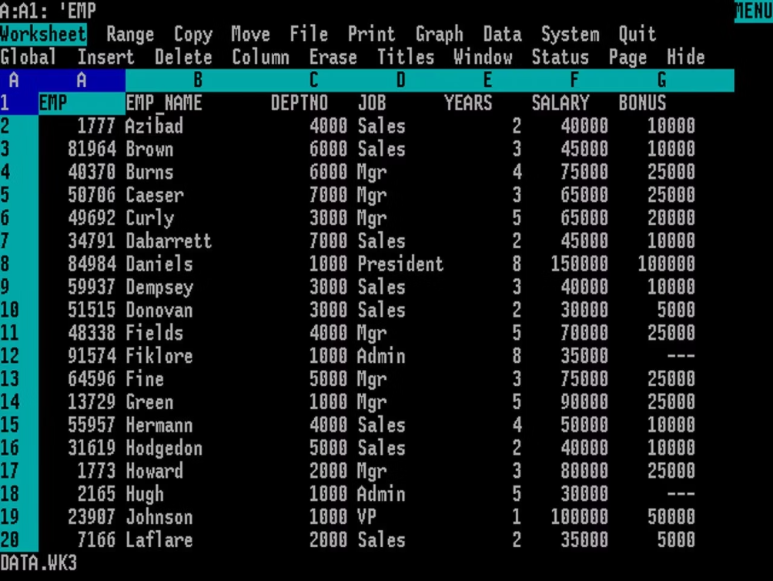
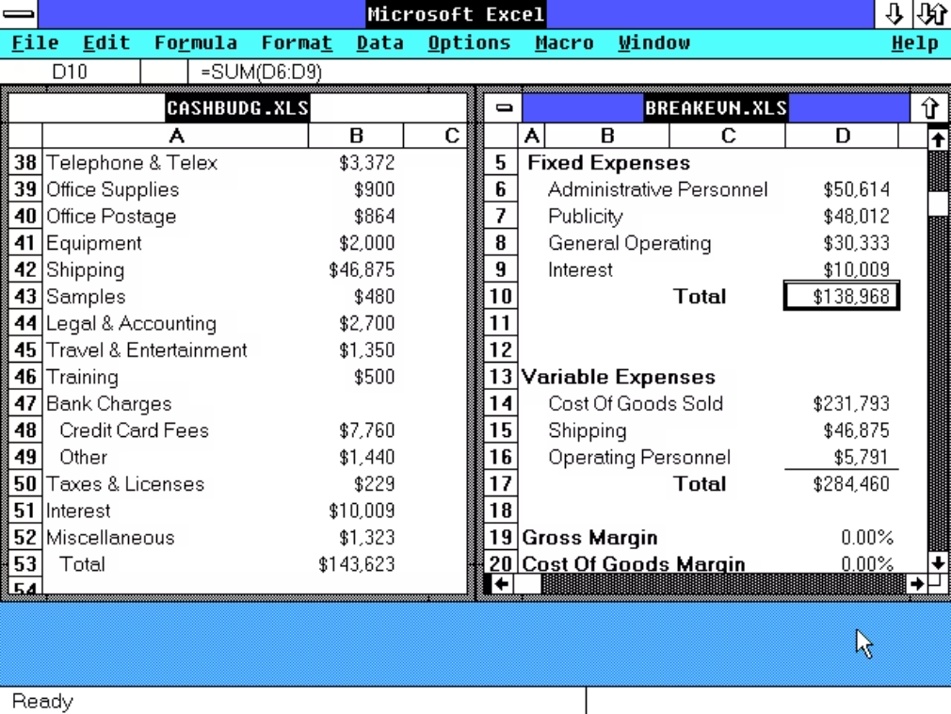
Change was only at the margins for the past 40 years
VisiCalc (1979)
Lotus 1-2-3 (1983)
Excel (1987)
For 40 years, the fundamental tool of business analysis remained essentially the same.

Slide 6

Now We're All Learning Together
AI has created an unprecedented situation:
Faculty, students, and industry professionals are all navigating the technological shift simultaneously.

Slide 7
Roadmap for Today's Discussion
1. A Course on AI for Finance
2. Previous Disruptive Technologies
3. AI in Finance Courses
4. AI in Education in General
5. Deep Dive into Claude Code

Slide 8

A Course on AI
for Finance

Slide 9
Core Themes
Chatting:
Building:
Treat AI as a colleague: collaborate, evaluate, iterate
Apps: to reuse tested code
Custom chatbots: system prompts, RAG, or fine tuning
Coding: LLMs are unreliable for arithmetic; coding is essential
Agents: chatbots with tools

Slide 10

Prompt Engineering
Ethan Mollick, Wharton:
Treat AI like an infinitely patient new coworker ... As it is a coworker, you want to work with it, not just give it orders, and you also want to learn what it is good or bad at ... Working with AI is a dialogue, not an order.
Students ask how to prompt, but practicing collaboration is the key.

Slide 11




Learning How to Work with AI
Learn Capabilities
Refine Prompts
Save & Reuse
Discover what AI does well and where it struggles through hands-on experimentation
Develop more precise prompts based on understanding of AI strengths and limitations
Build a library of effective prompts for common financial analysis tasks
Class Exercise: Chat with a chatbot about financial analysis, evaluate the output, then develop a reusable prompt that achieves better results faster for similar future analyses.

Slide 12


Using AI to Write Code
Y Combinator CEO Garry Tan and Managing Partner Jared Friedman, March 2025:
For roughly a quarter of the startups in our Winter 2025 cohort, 95% of the codebase was written by AI.

Slide 13


Claude + Python at Bridgewater
Aaron Linsky, CTO, AIA Labs at Bridgewater:
We've been developing capabilities powered by Claude since 2023 within AIA Labs.
Claude powered the first versions of our Investment Analyst Assistant, which streamlined our analysts' workflow by generating Python code, creating data visualizations, and iterating through complex financial analysis tasks with the precision of a junior analyst."

Slide 14
Coding Tools
Chatbots with Code Execution
Python Environments with AI
ChatGPT, Gemini, Claude, Julius.ai - integrated environments for coding and testing
Google Colab, VS Code, Cursor, Windsurf - traditional development enhanced by AI assistance
All-in-One Solutions
My Current Preference
Replit - complete development and hosting platform with AI integration
Claude Desktop (cloud Python) and Claude Code (local Python)

Slide 15
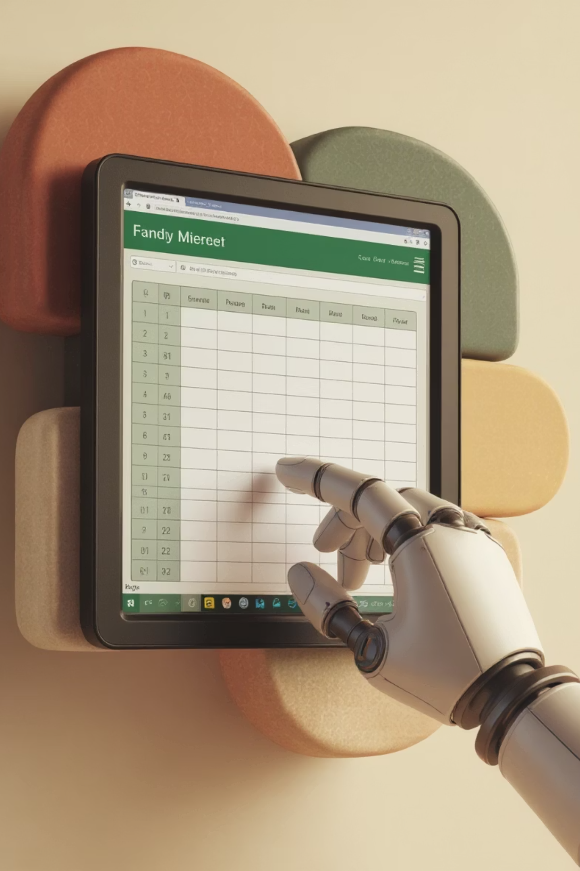
Claude Can Create Excel
Claude became able to generate fully functioning, nicely formatted Excel workbooks in September 2025. Microsoft has introduced the same Anthropic technology into Excel itself.
Claude prompt: "Create an Excel file illustrating two-stage DCF valuation."
Claude Excel File

Slide 16
Valuation with Claude
HBS Case Valuing Wal-Mart 2010:
Read the uploaded case. Ignore the valuation method described in the case. Do a two-stage DCF valuation. Create a PowerPoint deck and fully functioning and professionally formatted Excel workbook.
Document your assumptions and your reasons for them. Put years in columns and items in rows throughout the Excel workbook and PowerPoint deck.
Currently requires Claude Max subscription

Slide 17

Microsoft’s
Vibe Working
Powered by Claude

Slide 18
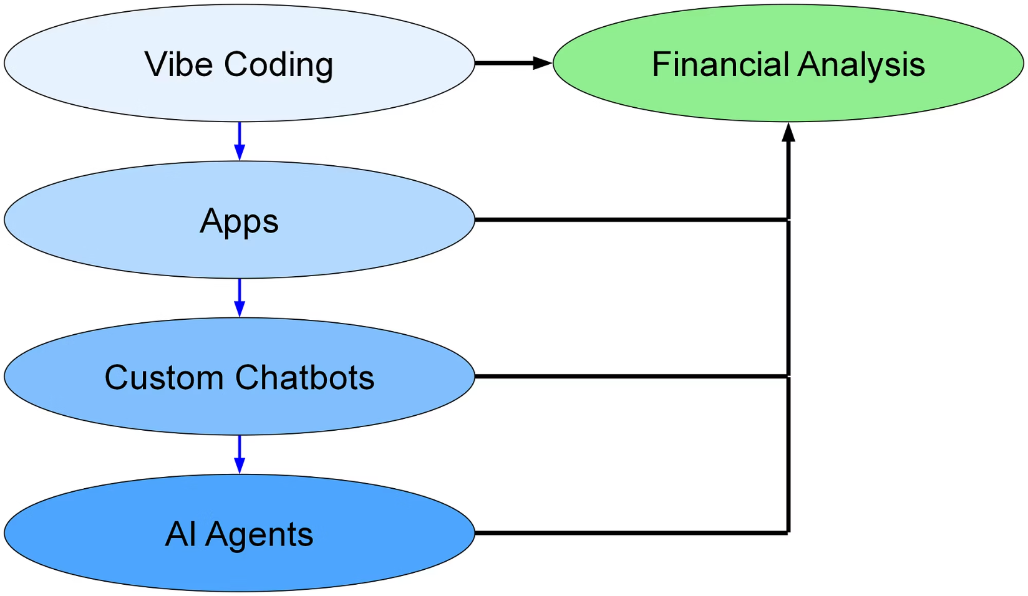
AI Plumbing
Store code in an app
Chatbots are apps
Agents are chatbots with
tools (tools=apps)

Slide 19
Why Teach the Plumbing?
Students gain perspective on how things fit together in the AI space
Students may end up at small or medium size firms and be the plumbers
Building apps/chatbots/agents to do finance can deepen understanding of finance
May check a box for recruiters

Slide 20
Why Teach the Plumbing?
Students gain perspective on how things fit together in the AI space
Students may end up at small or medium size firms and be the plumbers
Building apps/chatbots/agents to do finance can deepen understanding of finance
May check a box for recruiters
It’s fun!

Slide 21





Chatbots and Agents

Slide 22
Chatbot Elements
1
User Interface
The front-end interface where users interact with the system
2
API Connection
Secure connection to Large Language Model (OpenAI, Anthropic, Google, etc.)
3
System Prompt
Instructions that define the chatbot's behavior (on top of API system prompt)
4
Document Retrieval
Optional capability to access specific documents or knowledge bases
5
Tool Integration
Optional connections to external tools, databases, or APIs

Slide 23

System Prompts: The Foundation
A system prompt is text sent to the LLM alongside each user prompt.
It defines the chatbot's personality, expertise level, response format, operational constraints, and provides supplemental information for the LLM.
The system prompt in a custom chatbot adds to the system prompt of the LLM’s API.
Explore Anthropic's System Prompts

Slide 24
RAG: Retrieval Augmented Generation
Document Storage
Store relevant documents in a searchable database or vector store
Relevance Matching
Choose most relevant document chunks using vector similarity algorithms
Context Integration
Send relevant chunks to LLM along with user prompt and system prompt
RAG is a key element of many corporate AI implementations.

Slide 25

Notebook LM
Capabilities:
Chat
Audio overview
Video overview
Flash cards
Quiz
Reports
Mind map
Easy sharing in university Google accounts, even available in Canvas.
More on NotebookLM later.

Slide 26

Example RAG Chatbot
Visit chat.derivative-securities.org

Slide 27

Agents = Enhanced Chatbots
Definition
An AI agent is a chatbot equipped with tools to perform actions beyond conversation.
Database Integration
Database tools are particularly valuable for chatbots in financial applications.

Slide 28



Claude for Financial Services:
Anthropic: Through data providers, Claude (for Financial Services) has real-time
access to comprehensive financial information.
Data Platforms
Financial Data
Market Intelligence
Box, Daloopa, Databricks
FactSet, Morningstar,
Palantir
PitchBook, S&P Global, Snowflake

Slide 29
Why MBAs Should Learn about Agents
Fortune, September 14, 2025:
PromptQL, an enterprise AI platform created by San Francisco-based developer tooling company Hasura, is doling out $900-per-hour wages to its engineers tasked with building and deploying AI agents to analyze internal company data using large language models (LLMs).
Tanmai Gopal, PromptQL's cofounder and CEO, said 'MBA types ... are very strategic thinkers, and they're smart people, but they don't have an an intuition for what AI can do.'

Slide 30
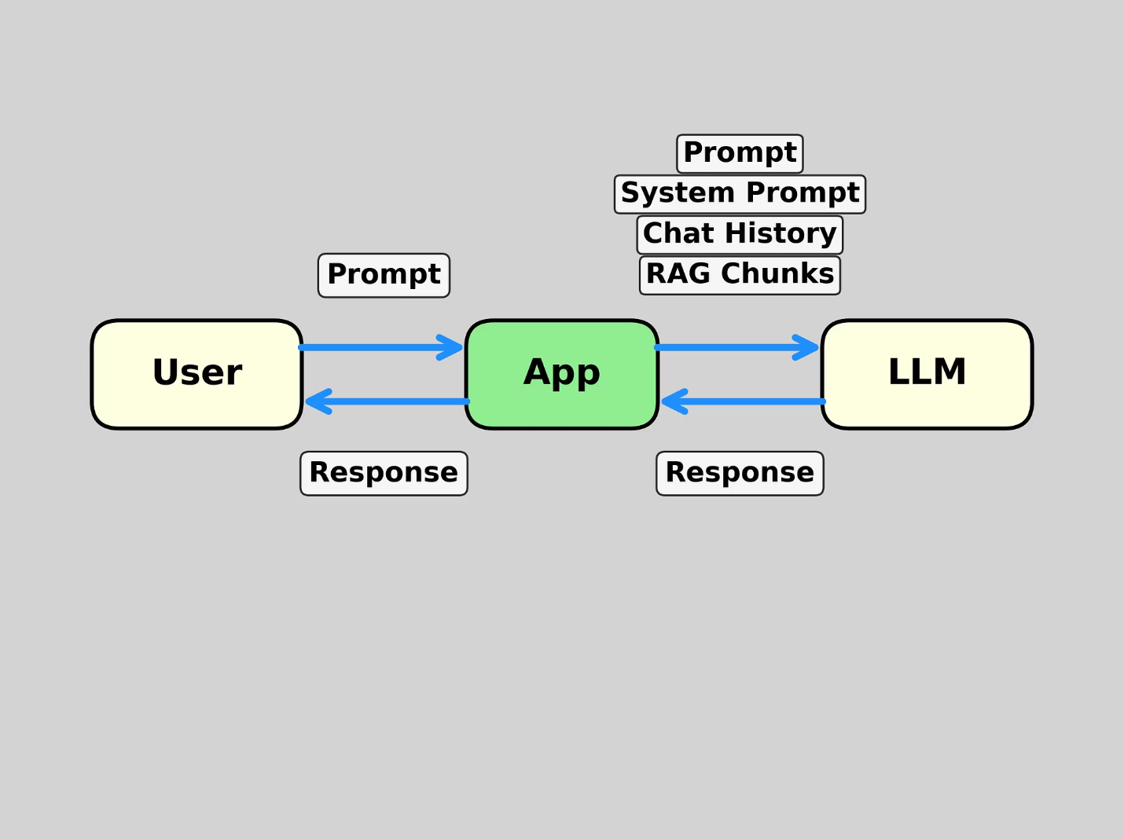
Chatbot
Architecture

Slide 31
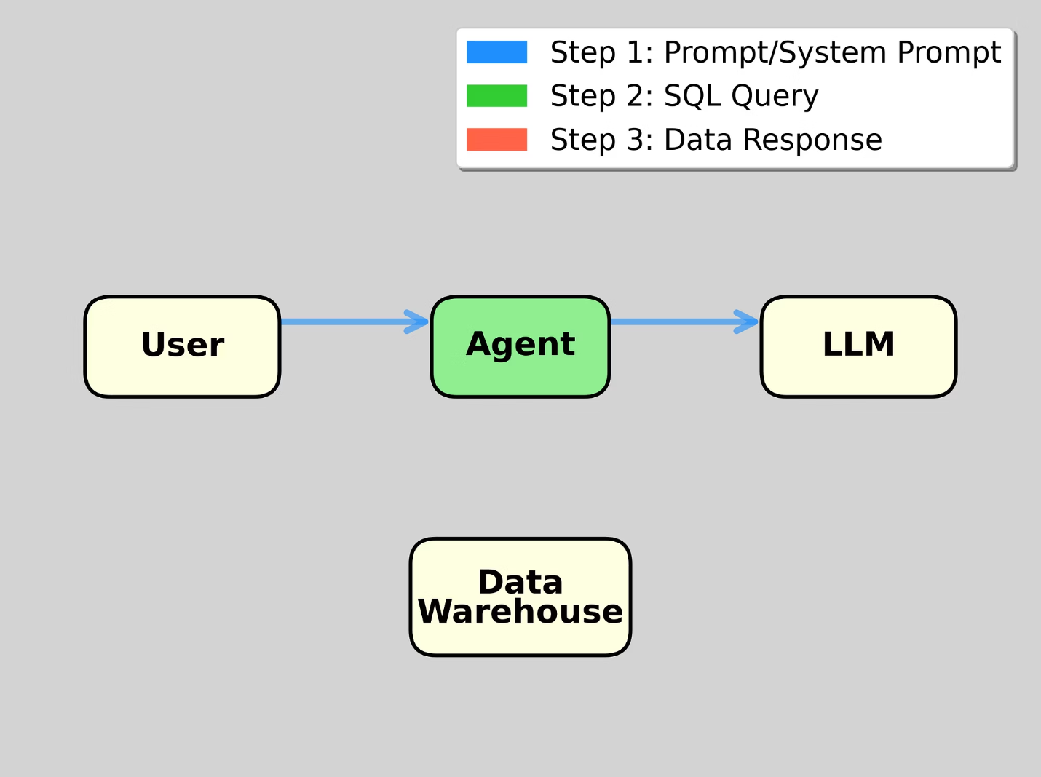
Database Agent
(1) User prompt → LLM
May be multiple rounds
to clarify prompt

Slide 32
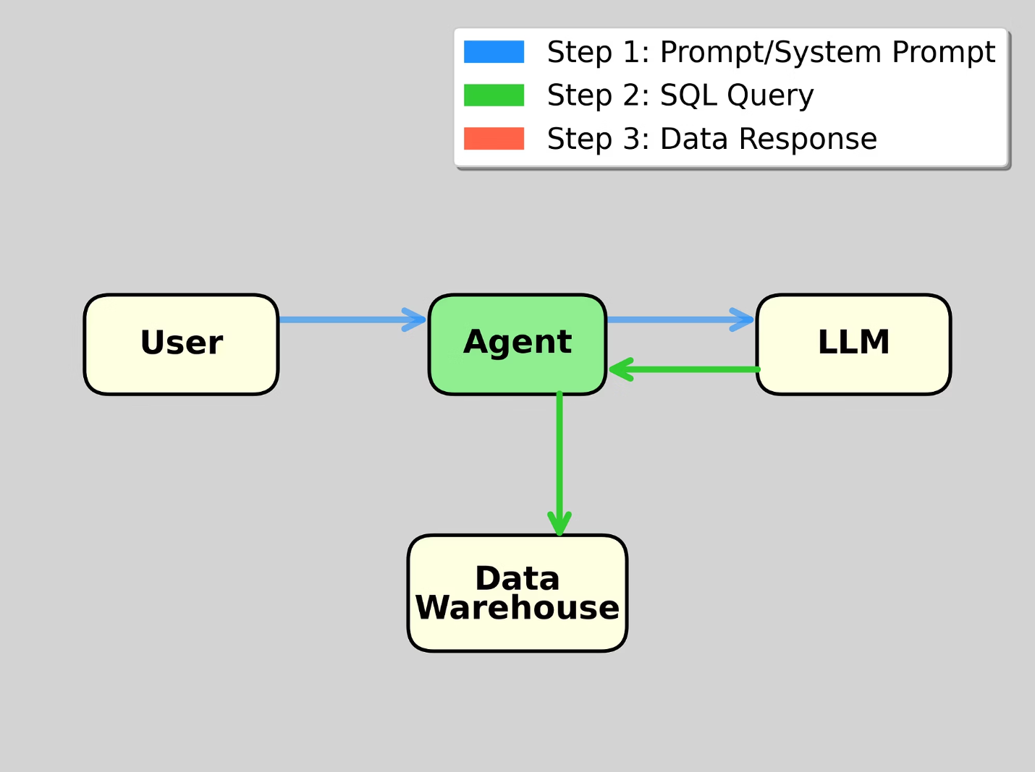
Database Agent
(2) SQL → Data Warehouse

Slide 33
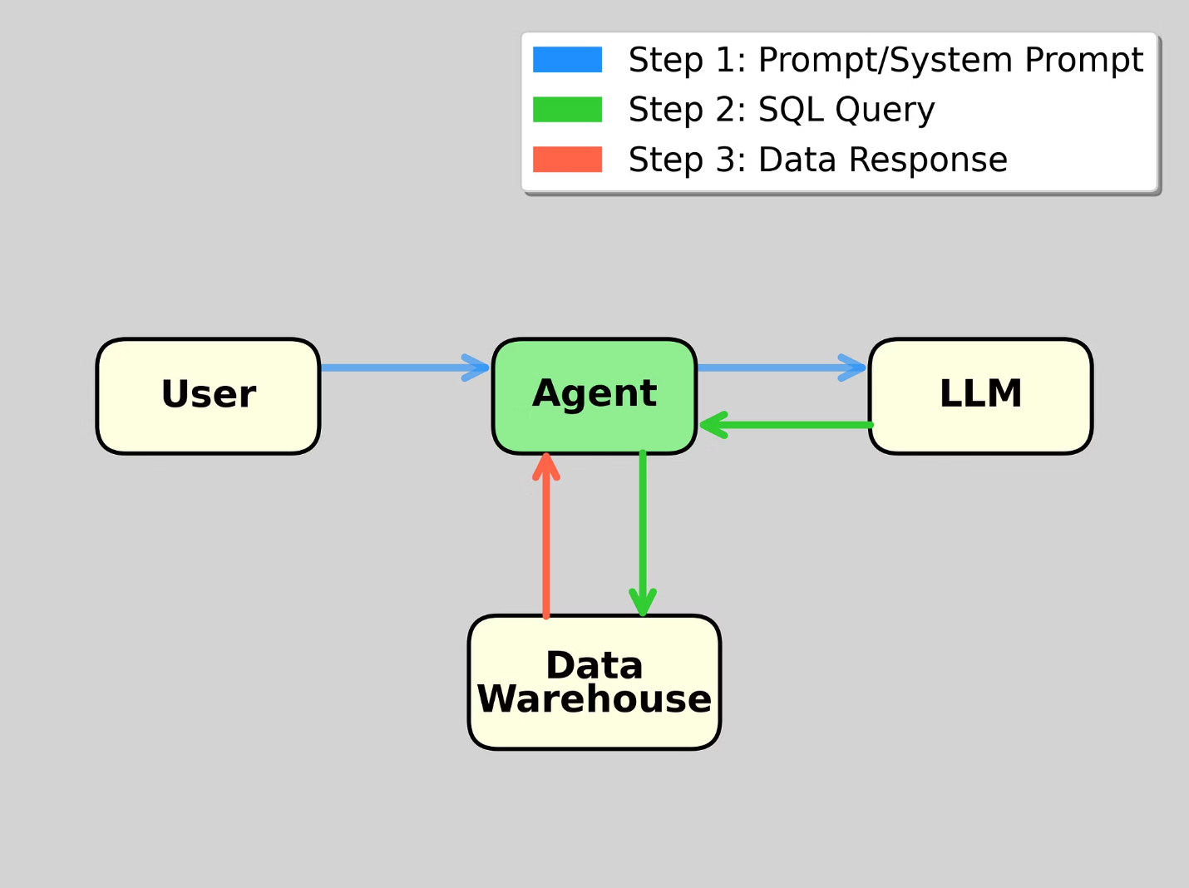
Database Agent
(3) Data or Error → Agent
Error message will be sent
to LLM for new SQL

Slide 34
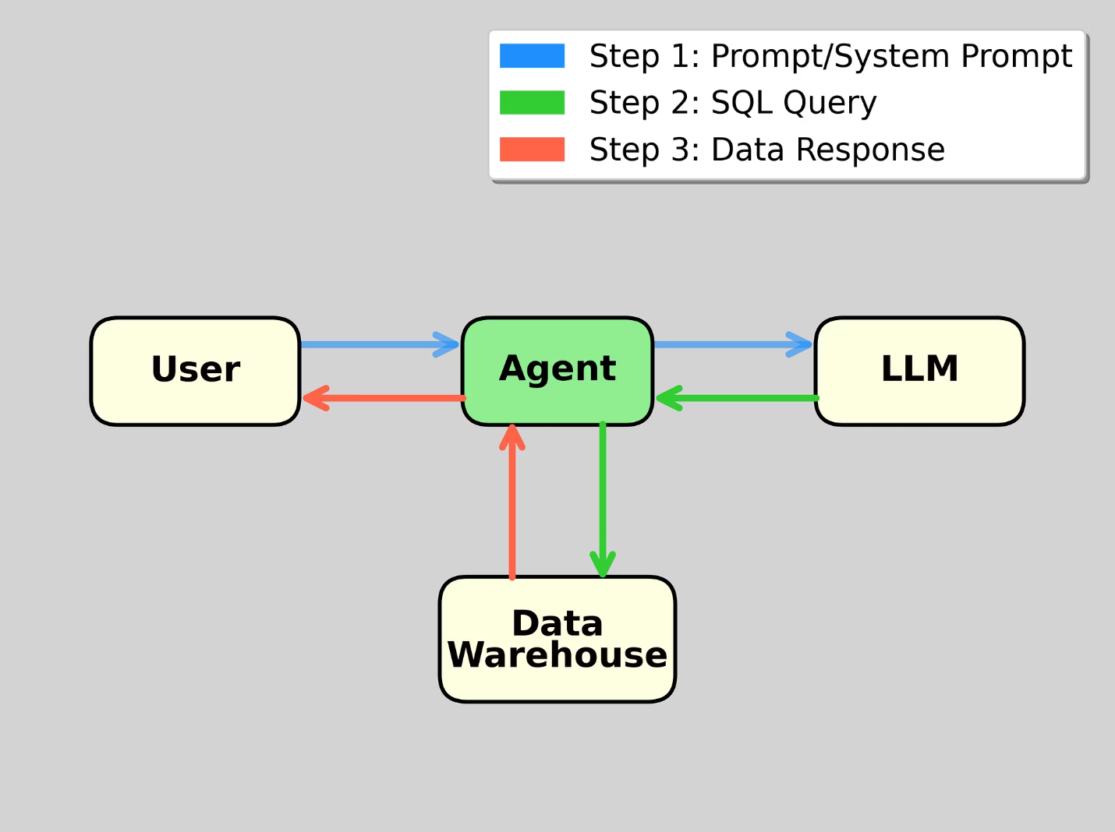
Database Agent
(3) Data → User
Could attach more tools.
For example, Python to
analyze data.
Then Output → User

Slide 35

Example: Rice Business Data Portal
Visit data-portal.rice-business.org
Demonstrates how students (and workers) can interact with complex databases using natural language.

Slide 36
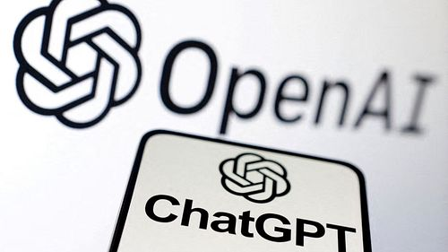



No-Code Solution:
OpenAI Custom GPT
System prompt
RAG
OpenAI tools: Web, Python, Dall-E
External APIs and services
Deploys within ChatGPT (GPT Store)
ChatGPT Plus subscription required for both creators and users

Slide 37

OpenAI's Agent Builder (AgentKit), released 10-6-2025
Visual canvas for building multi-step AI agent workflows without coding
Empowers users to visually assemble, debug, and export complex agent workflows
When you're ready to deploy, embed the workflow into your site with ChatKit, or download the SDK code to run it yourself.

Slide 38

Previous Disruptive Technologies

Slide 39

Handheld Calculators
The Concerns
Educators worried students wouldn't learn fundamental arithmetic operations
The Reality
Studies haven't found significant negative effects on basic math skills. However, primary schools still provide practice and assessments without calculators.
Some hoped schools could move beyond calculation to teach deeper mathematical concepts. That didn't happen either.

Slide 40

Personal Computers & Spreadsheets
We added courses on how to use spreadsheets
We updated existing courses to use spreadsheets
We assess how well students can use spreadsheets (no pencil and paper valuation analyses)
Teaching how to do finance in spreadsheets is a main educational goal.

Slide 41



Why Spreadsheets Succeeded
Business Relevance
Educational Value
Tool Evolution
Spreadsheets are extensively used in real business environments
Ideal for teaching the logic of valuation and capital budgeting concepts
Spreadsheets don't automatically do what we want students to learn

Slide 42
AI: A Different Challenge
✓ Business Usage
✓ Educational Tool
✗ Automation Risk
AI is increasingly used across business functions
AI provides excellent tutoring and learning support
AI can automatically perform many tasks we previously taught manually
AI is more like calculators than spreadsheets. We face similar concerns about skill acquisition. Like primary schools with arithmetic, we'll need practice and assessments without AI to ensure fundamental competencies.

Slide 43

AI in Finance Courses

Slide 44

The New Skills Landscape
Brookings Institute, 2025:
As AI models begin to handle underwriting, compliance, and asset allocation, the traditional architecture of financial work is undergoing a fundamental shift.
As job descriptions evolve, so does the definition of financial talent. Excel is no longer a differentiator. Python is fast becoming the new Excel.
But technical skills alone will not cut it. The most in demand profiles today are those that speak both AI and finance.

Slide 45



A New Teaching Sequence
Concepts First
Begin with fundamental concepts using slides or whiteboard as usual
Tool Implementation (Maybe?)
Demonstrate implementation in traditional tools (usually Excel) as usual
AI Enhancement
New step: Apply concepts using chatbots and AI agents
Traditional Approach
Additional Piece
Teach Excel implementation → students build Excel models
Teach AI implementation → students conduct AI chats or build AI apps

Slide 46

Straight from Slides/Whiteboard to AI?
Linear regression
Simulation
Mean-variance Optimization
Option valuation
DCF analysis

Slide 47


Straight from Slides/Whiteboard to AI?
Linear regression
Simulation
Mean-variance Optimization
Option valuation
DCF analysis

Slide 48

AI in Education in General

Slide 49
Three Legs of Assessment
Assignments
Exams Without AI
Exams With AI
"Turn in your chat, its output, and your evaluation of the output"
In-class assessments ensuring students understand fundamental concepts independently
More ambitious assessments leveraging AI assistance - complex cases can become exams with AI support

Slide 50
AI as Educational Partner
AI can be a highly effective tutor, and we should leverage it in our teaching.
Replace Reading Assignments
Pre-Class or In-Class
Ask students to chat with chatbots instead of traditional reading assignments
Assign pre-class or in class before slides and class discussion.
Assignment: "Ask your chatbot to teach you about [topic]. Tell it to ask you questions to ensure you are understanding."

Slide 51
If Chatbot Reliability is a Concern
Use RAG
Build with AI Reports
Reliability Reality
Build custom systems (could use Google's Notebook LM or Custom GPT) for specific source control
Can have AI create a comprehensive report, then edit if needed and use for RAG or in system prompt
LLMs today are significantly more reliable than earlier versions - hallucinations have diminished

Slide 52
NotebookLM Example
Step 1:
I asked ChatGPT to prepare a detailed report on binomial option in markdown format. I could have used a different chatbot.
Step 2:
I uploaded the markdown file to NotebookLM and asked it to generate flash cards and a video overview.
Link to ChatGPT conversation:
https://chatgpt.com/share/68e7cbf4-013c-8006-89bb-1166720463ff
Link to NotebookLM notebook:
https://notebooklm.google.com/notebook/7e3e40f0-a937-46cb-8eea-7c713bdcb8d4
Link to NotebookLM video:
https://genai4finance.kerryback.com/Binomial_Option_Model.mp4

Slide 53
Effect of AI on Junior Employment
Harvard economists' study:
AI is reducing employment of junior workers but not senior workers
Lichtinger and Maasoum (20,000+ SSRN downloads in one month)
JPMorgan quote:
"Many, many of the processes underneath are being done by AI."
Junior professors?
Scott Latham, UMass, Chronicle of Higher Education:
Are you Ready for the AI University?

Slide 54

Deep Dive into Claude Code

Slide 55

Claude Code
Part of a new generation of terminal-based coding agents, along with OpenAI Codex and Gemini CLI.
It integrates well with popular development environments like VS Code.
Built on standard Anthropic models, Claude Code appears to have an exceptionally well-designed system prompt that optimizes it for development tasks.
Requires Claude Pro subscription

Slide 56




Claude Code’s Capabilities
File Operations
Python Development
Create, edit, copy, move, and delete files
Write, edit, and execute Python scripts and Jupyter notebooks
Document Creation
Deployment
Generate and edit LaTeX documents. Generate Word docs and PowerPoint presentations
Create GitHub repositories and deploy apps on hosting platforms like Hugging Face Spaces, Streamlit Community Cloud, Koyeb, and Render

Slide 57


Claude Code in VS Code Demo
Create a Jupyter notebook for mean-variance optimization.
Prompt the user for the number of assets, their means, standard deviations, and correlations and the risk-free rate.
Only ask for the minimum number of correlations required to compute the correlation matrix.
Assume short sales are allowed.
Compute and display the tangency portfolio.

Slide 58

MCP Servers
Anthropic's Model Context Protocol (MCP) enables adding custom tools to chatbots. I've added an MCP server for the Rice database to my Claude Code setup.
Demo Query: Get TSLA's ROE by quarter on a trailing 4-quarters basis for Q1 2020 through Q3 2025 from the Rice stock database.
Get TSLA's adjusted closing price starting Jan 1, 2020. Filter to keep only end-of-quarter prices.
Plot the ROE and filtered price series in the same figure, with ROE on the left y-axis and price on the right y-axis.

Slide 59
When Should Students Learn Claude Code
Or the Current Best AI Tool
○ First term as a tools course (or in Data Analysis, for example)
○ Last term as an advanced elective

Slide 60
When Should Students Learn Claude Code
Or the Current Best AI Tool
● First term as a tools course (or in Data Analysis, for example)
○ Last term as an advanced elective
HBS licensed Julius.ai and is introducing it in Data Analysis.

Slide 61

Domain Knowledge will be More Important than Ever
AI will level the playing field for tool skills (assuming students can use AI).
That will make domain knowledge more important than ever as a differentiator.

Slide 62

Some Additional Resources
Scan the QR code to access genai4finance.kerryback.com

